Slide 1

Springboard capstone project 1

Slide 2

Problem identification
The project aims to solve advise management on the optimal resort prices so that the facilities have higher utilization rate and different facilities can be charged with a different price depending on the importance, to increase profit for the resort, by the end of the season.

Slide 3
Recommendation and key findings
Pricing: Big Mountain Resort modelled price is $94.22 versus actual price is $81.00
Possible changes:
Permanently shutting down up to 10 of the least used runs
Increasing the vertical drop by adding a run 150 feet lower down, requiring an additional chair lift
Similar to scenario 2, but adding 2 acres of snow making coverage

Slide 4
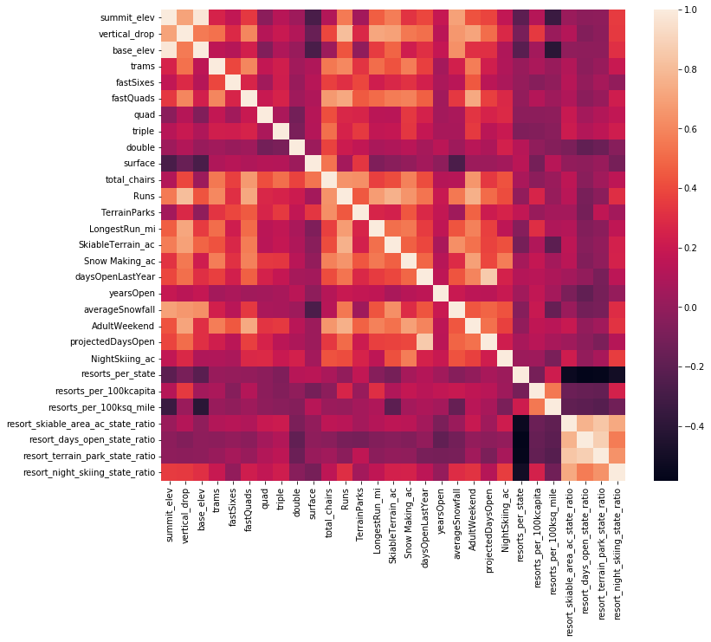
Exploratory analysis
The dataset contains 28 numerical features, and 4 textual features.
fastQuads, Runs, Snow Making_ac and total_chairs showed strong correlations.
The newly engineered feature resort_night_skiing_state_ratio also exhibited a notable correlation with ticket prices.

Slide 5
Model selection and pipeline
Imputer
Impute missing data with median
Scaler
Scale values to standardize them
Random forest regressor
Fit random forest regression with random state =47
Cross-validation
K = 5
Default score = R-squared
Hyperparameter tuning
Using GridSearch
Optimal Random state = 69
Imputing with median is optimal
Scaling the feature is unnecessary

Slide 6
Modeling results and analysis
Model selected: Random Forest Model
We used median and mean to impute values
Trained and evaluated using 5-fold cross-validation
Overall achieved R-squared of 71% and an MAE of 9.5
Key features identified as important in the model include: vertical_drop, Snow Making_ac, total_chairs, fastQuads, Runs, LongestRun_mi, trams, and SkiableTerrain_ac.

Slide 7
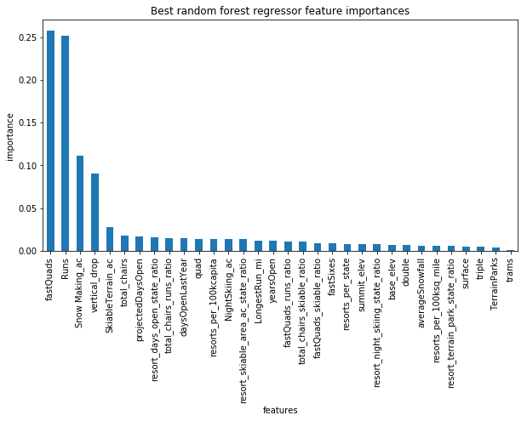

Slide 8
Scenario building and analysis
Permanently shutting down up to 10 of the least used runs → Predicted price decrease of $1.71 by the 10th run.
Increasing the vertical drop by adding a run 150 feet lower down, requiring an additional chair lift → Predicted price increase of $1.99, potentially amounting to $3,474,638 over the season.
Similar to scenario 2, but adding 2 acres of snow making coverage→ Predicted price increase of $1.99, potentially amounting to $3,474,638 over the season.
Increasing the longest run by 0.2 miles, requiring an additional 4 acres of snow making coverage→ No significant difference in the predicted price observed.

Slide 9
Summary
In summary, we built a prediction on the optimal prices, and recommend increasing the current price on Big Mountain resort.
To enhance the model's predictive capabilities, additional data, such as customer demographics, might be required.
The model can be implemented on a server, retrained, and accessed by analysts to generate new predictions given updated data.
Continued optimization and monitoring can provide valuable insights.

